Slide 1
Manifold Learning and Artificial Intelligence
Lecture 2
Introduction 2
Meeting ID: 933 1613 9423
Passcode: 416262
https://uwmadison.zoom.us/j/93316139423?pwd=Q0NVWFYvRFg5RmxCNkwxMmYrbW41dz09
momiao. xiong@gmail.com
shihcheng.guo@gmail.com
Github Address: https://ai2healthcare.github.io/

Slide 2
Introduction 2
Genomic, Molecular, Protein and Biomedical Application
Diffusion Models, Stochastic Differential Equation, Heat Diffusion Equation, Generating Content, Protein Design, Drug Repurposing, Molecular Graph Generation, Antibody Design, Manifold Alignment, Survival Analysis
News
NIPS 2022, Number of Papers in Manifold Learning: 97
Number of papers in Diffusion Models : 59
Number of Papers in Graphic Analysis : 384
ICML 2022, Number of Papers in Manifold Learning: 81
Number of Papers in Diffusion Models: 60
Number of Papers in Graphic Analysis: 269

Slide 3
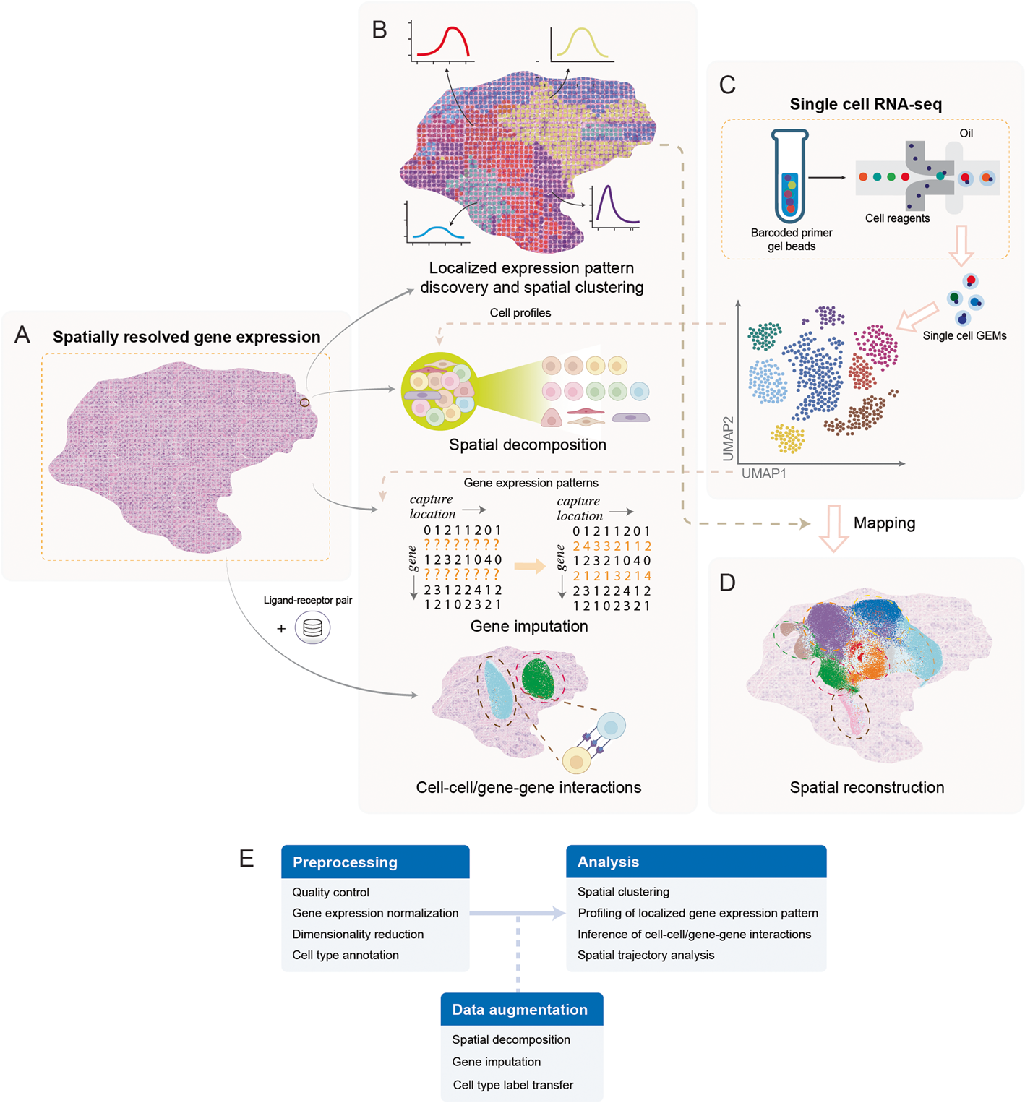
1.2. 1. Spatially Transcriptomics Data Analysis in Manifolds
Zeng et al.Statistical and machine learning methods for spatially resolved transcriptomics data analysis
Genome Biology (2022) 23:83

Slide 4
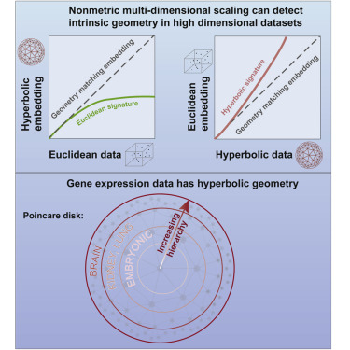
1.2.2. Gene Expression in Manifolds
Gene expression shows hyperbolic geometry structure
High-dimensional data are embedded in low manifold.
Hyperbolic geometry of gene expression
Zhou & Sharpee, iScience 24,102225, March 19, 2021

Slide 5
Patterns of gene expressions play a key role in determining cell state. Although correlations in gene expressions have been well documented, most of the currentmethods treat them as independent variables. One way to take into account gene correlations is to find a low-dimensional curved geometry that describes variationin the data. Here we develop such a method and find that gene expression across multiple cell types exhibits a low-dimensional hyperbolic structure. When more genes are taken into account, hyperbolic effects become stronger but representation remains low dimensional. The size of the hyperbolic map, which indicatesthe hierarchical depth of the data, was the largest for human cells, the smallestfor mouse embryonic cells, and intermediate in differentiated cells from differentmouse organs. We also describe how hyperbolic metric can be incorporated intothe t-SNE method to improve visualizations compared with leading methods

Slide 6
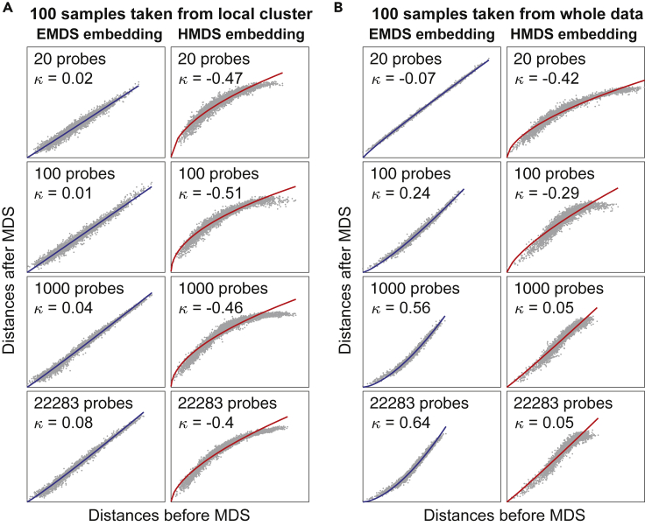
1.2.2. Gene Expression in Manifolds
Human gene expression has locally
Euclidean and globally hyperbolic
hidden geometry
Zhou & Sharpee, iScience 24,102225,
March 19, 2021

Slide 7
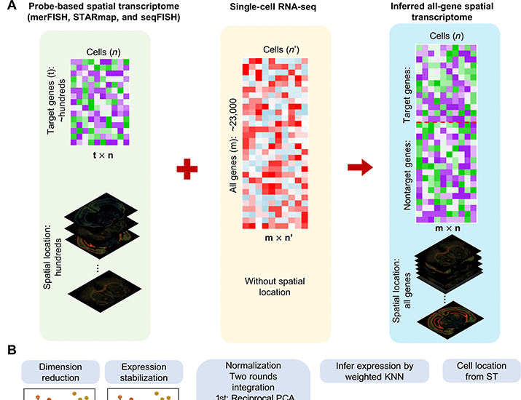
1.2.3. Infer Genome-wide Spatial Expression
Manifold alignment ?
Zhang et al. 2022. Accurate inference of genome-wide spatial expression with iSpatial
SCIENCE ADVANCES, 26 Aug 2022, Vol 8, Issue 34

Slide 8
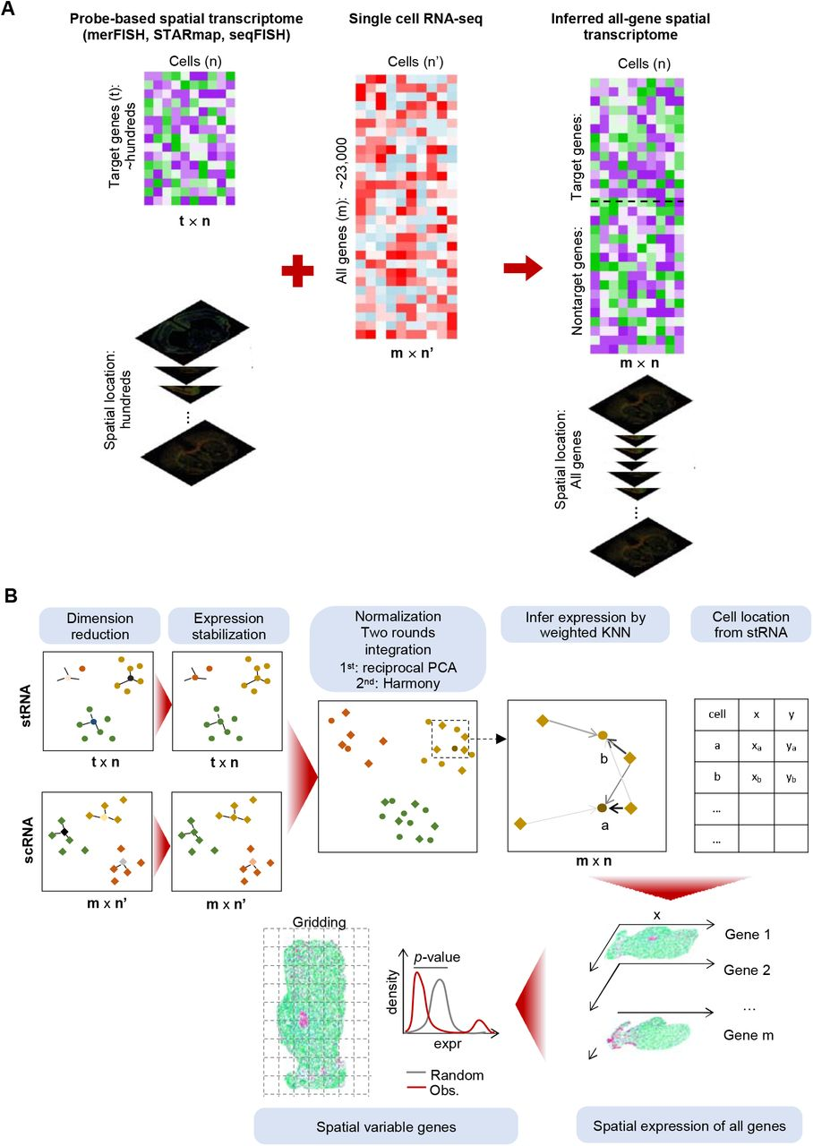
1.2.3. Infer Genome-wide
Spatial Expression
Replace by AI ?
Dimension Reduction
In Manifold?

Slide 9
Assumption and Goals
The disparate datasets being aligned have the same underlying manifold structure.
Manifold alignment can therefore be viewed as a form of constrained joint dimensionality reduction where the goal is to find a low-dimensional embedding of multiple datasets that preserves any known correspondences across them
And to find shared latent semantic structure.

Slide 10
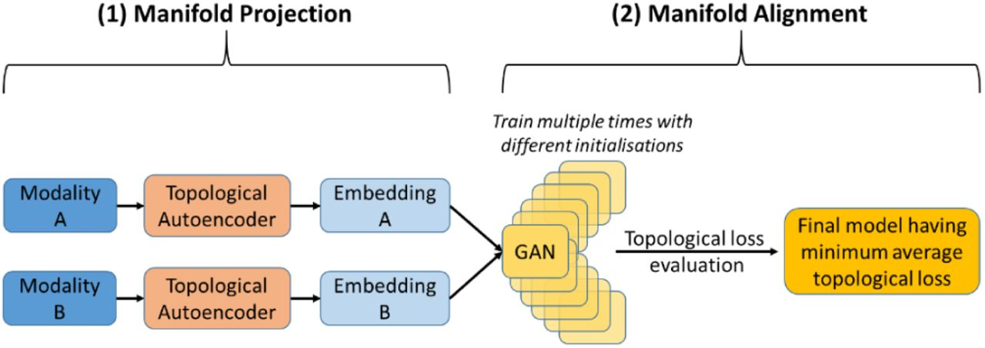
1.2.3. Infer Genome-wide Spatial Expression
TopoGAN: unsupervised manifold alignment of single-cell data
Single Cell RNA-seq data
Space Location Data
Akash Singh, 2022.
doi: https://doi.org/10.1101/2022.04.27.489829

Slide 11
Generative Adversarial Networks (GANs)
X’=G(Z)
Fake Sample
G(Z)
Real or
Fake
Discriminator
Z
X
Flataned
Source Manfold
Real Data (Target Manifold)

Slide 12
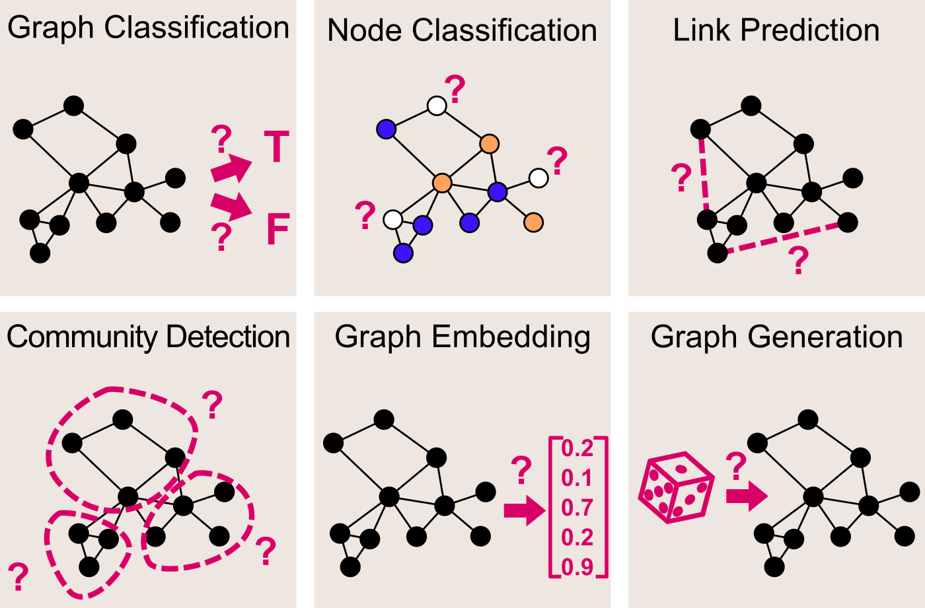
1.3. Graph Neural Networks (GNN)
1.3.1. Application of GNN
Francesco Casalegno, 2021, Graph Convolutional Networks —Deep Learning on Graphs.
https://towardsdatascience.com/graph-convolutional-networks-deep-99d7fee5706f

Slide 13
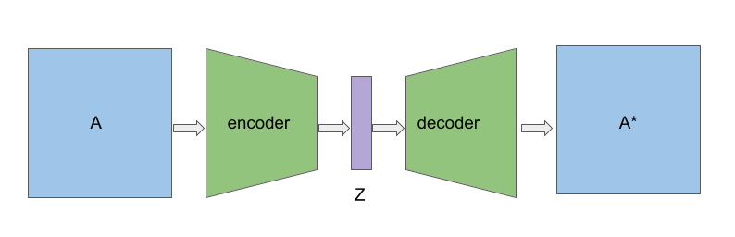
1.3. Graph Neural Networks (GNN)
1.3.2. GNN as autoencoder

Slide 14
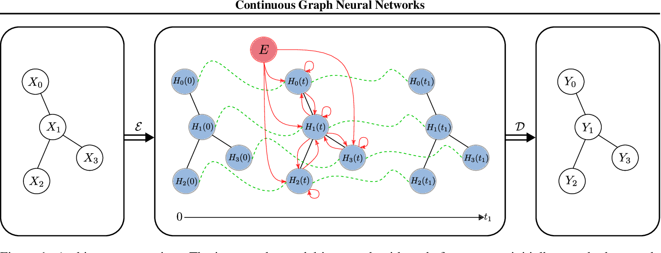
1.3. Graph Neural Networks (GNN)
1.3.3. Continuous GNN as Autoencoder
The input to the model is a graph neural network (GNN). In the middle, a differential equation is used to model changing of the representation of the GNN over time. Finaly, GNN is again used to decode the network. The red lines represent the information transfer as defined by the ODE.
Xhonneux et al.
arXiv:1912.00967
Continuous Graph Neural Networks

Slide 15
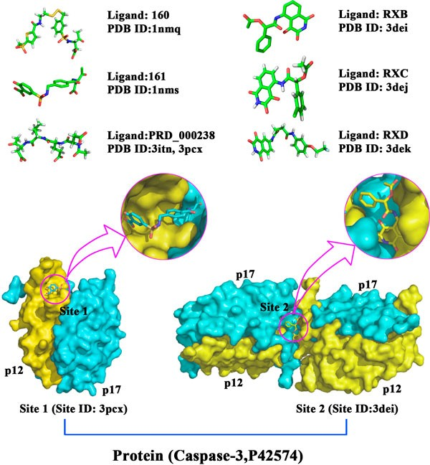
1.3. Graph Neural Networks (GNN)
1.3.4. Illustration of protein ligent biding sites

Slide 16
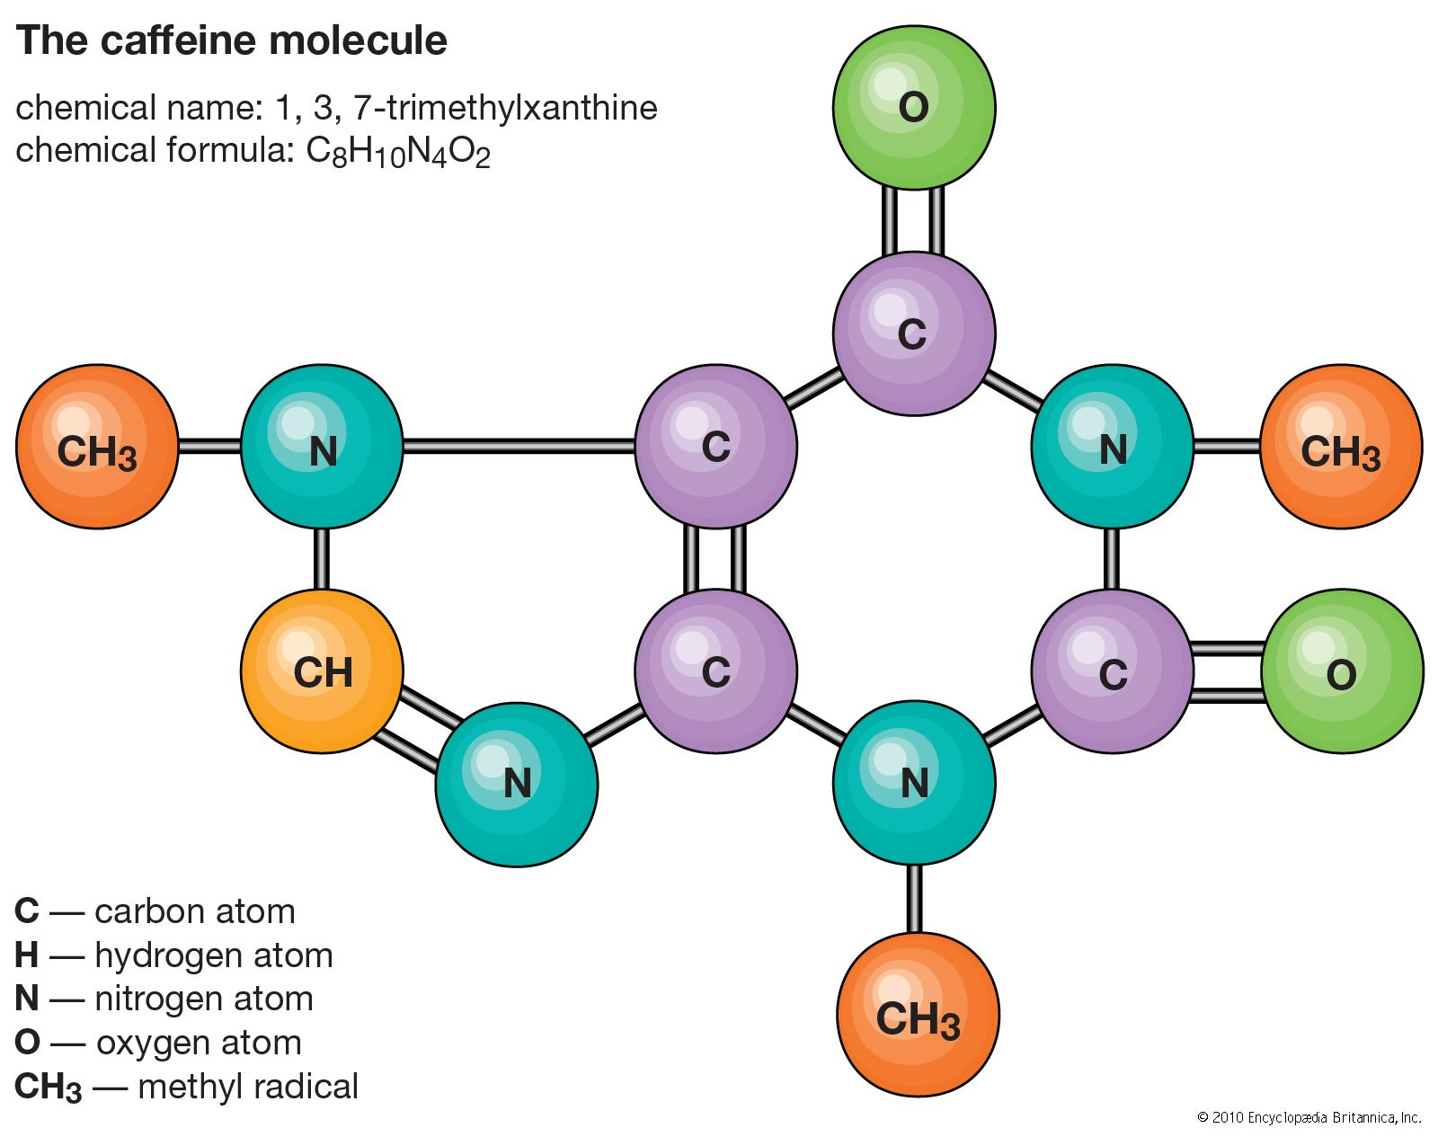
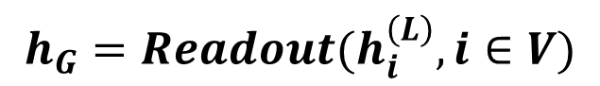
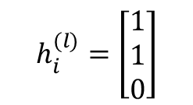
1.3. Graph Neural Networks (GNN)
1.3. 5.1. Undirected Message Passing Neural Networks
i
$$h_{i}^{(l)}=\left[\begin{matrix}1 \\ 1 \\ 0\end{matrix}\right]$$
$M_{ji}^{(l)}=MSG\left(h_{j}^{\left(l\right)}, h_{i}^{\left(l\right)},e_{ji}\right), h_{i}^{(l+1)}=Update (h_{i}^{\left(l\right)},AGG(M_{ji}^{\left(l\right)}, j∈N_{i})$
$$h_{i}^{(l+1)}=f^{\left(l+1\right)}\left(h_{i}^{\left(l\right)}, {AGG}_{j∈N_{i},}∅^{\left(l+1\right)}\left(h_{i}^{\left(l\right)}, h_{j}^{\left(l\right)}, e_{ji}\right)\right), l=1,…, L$$
$$h_{G}=Readout(h_{i}^{\left(L\right)}, i∈V)$$
Update
Message Passing

Slide 17
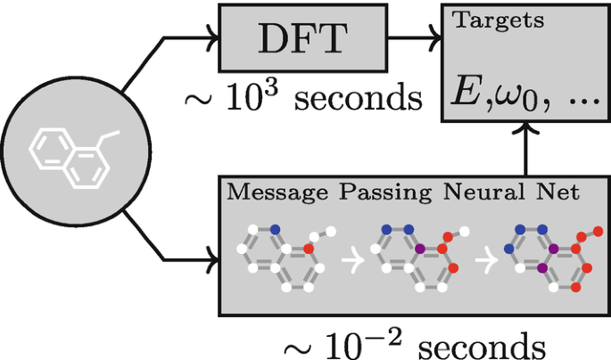
1.3.5.2. Illustration

Slide 18
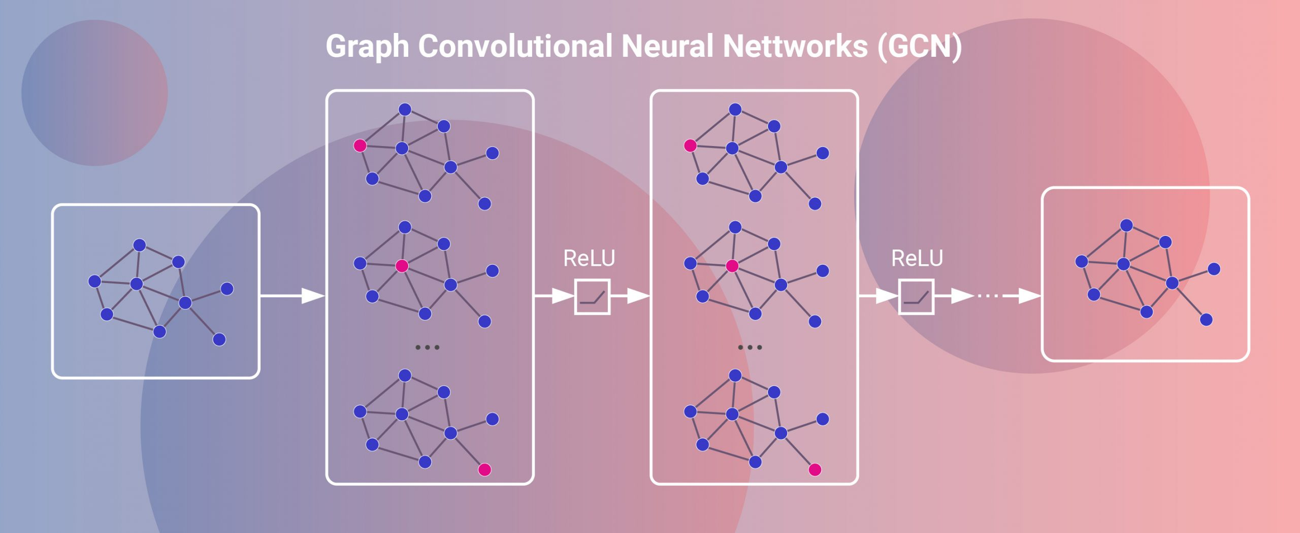
1.3. Graph Neural Networks (GNN)
1.3.6. Graph convolutional network (GCN)
Demush R. 2021. Gentle introduction to graphifcal neural networks and graph convolutional networks.

Slide 19
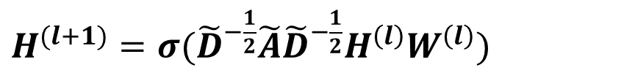
1.3. Graph Neural Networks (GNN)
1.3.7. Graph convolutional network (GCN)
For each layer, we have the following update rules:
${MSG}_{j}=W^{(l)}h_{j}^{(l)}, {AGG}_{i}=\sum_{j∈N_{i}}{\frac{1}{\sqrt{d_{i}d_{j}}}{MSG}_{j}, {Update}^{(l+1)}=σ(\frac{1}{d_{i}}W^{\left(l\right)}h_{i}^{\left(l\right)}+{AGG}_{i})}$
$h_{j}^{(0)}=x_{j}, W^{(l)}∈R^{D×D}, d_{i}$ is the number of edges connected to the node i.
Matrix Form:
$H^{(l+1)}=σ({\tilde{D}}^{−\frac{1}{2}}\tilde{A}{\tilde{D}}^{−\frac{1}{2}}H^{\left(l\right)}W^{\left(l\right)})$
$\tilde{A}=A+I_{N}, H^{(0)}=X, H^{(l)}∈R^{N×D},W^{(l)}∈R^{N×N}, A$ is an adjancy matrix. ${\tilde{D}}_{ii}=\sum_{j}{{\tilde{A}}_{ij}}$
Kipf and Welling (2017).
SEMI-SUPERVISED CLASSIFICATION WITH GRAPH CONVOLUTIONAL NETWORKS
arXiv:1609.02907

Slide 20
1.4. Diffusion Model and Stochastic Differential Equation
Heat Diffusion Equation
In Manifolds
Heat Diffusion Equation
Diffusion Models
Stochastic
Differential Equations
Manifold Stochastic
Differential Equations

Slide 21
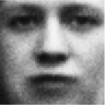
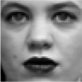
1.4.1. Score-based Methods for Generative Models
1.4.1.1. Early Generative Models in AI
real or fake?
Generative (Input Noise)
Real world
Discriminative Model

Slide 22



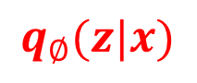
Early Generative Model
1.4.1.2. VAE
Encoder
Decoder
Latent
Space
Z
$$X$$
$$\hat{X}$$
Input
$$q_{∅}(z|x)$$
$$P_{θ}(x|z)$$
Output

Slide 23
1.4.3. Diffusion for Generative Models
Noise Perturbation, Forward Diffusion Process
Optimal Score
Stochastic Gradient Methods, Langevin Dynamics
And Reverse Diffusion Process
Song et al. 2021 , SCORE-BASED GENERATIVE MODELING THROUGH STOCHASTIC DIFFERENTIAL EQUATIONS
arXiv:2011.13456v2

Slide 24
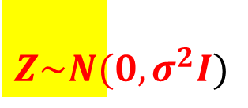
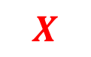
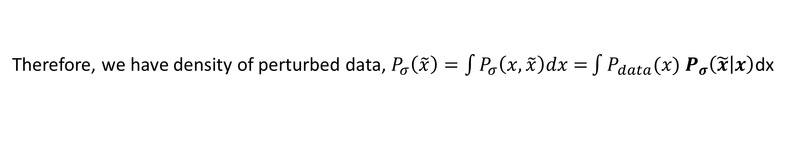

1.4.3.1.Noise Perturbation, Forward Diffusion Process
$Z\sim N(0, σ^{2}I)$
Perturbation Kernel:
$$X$$
$$P_{σ}\left(\tilde{x} | x\right)=N(\tilde{x};x, σ^{2}I)$$
Therefore, we have density of perturbed data, $P_{σ}\left(\tilde{x}\right)=\int{P_{σ}\left(x,\tilde{x}\right)dx=}\int{P_{data}(x)}$ $P_{σ}\left(\tilde{x} | x\right)$dx
Consider a sequence of positive noise scales: $σ_{min}=σ_{1}<σ_{2}<…<σ_{N}=σ_{max}$
$$\tilde{x}=x+σ^{2}ε, ε\sim N\left(o,I\right),$$
$$σ_{min}≈0, →P_{σ_{min}}\left(\tilde{x}\right)=P_{data}\left(x\right),σ_{max} ↑,P_{σ_{max}}(\tilde{x})=N(0, σ_{max}^{2}I)$$
Forward Diffusion Process: ${\tilde{x}}_{1}→{\tilde{x}}_{2}→…{\tilde{x}}_{N}$

Slide 25
1.4.3.2. Optimal Score
Recall score function in Statistics
Let $L\left(x,θ\right)$ be a likelihood function. The score function is defined as
$U\left(θ\right)=\frac{∂\log{L(x,θ)}}{∂θ}$.
Define Scores in Diffusion Models:
Consider i.i.d. samples $\left\{x_{1}, …, x_{n}\right\}, x_{i}∈R^{d}$.
Unnormalized distribution for model:${\tilde{P}}_{m}(x, θ)$
Normalized distribution for model: $P_{m }\left(x,θ\right),P_{m }\left(x,θ\right)=\frac{{\tilde{P}}_{m}(x, θ)}{Z(θ)}. Z\left(θ\right)=\int{{\tilde{P}}_{m}\left(x, θ\right)dx}$
Score for Data: ${ S}_{data}\left(x\right)=∇_{x}\log{P_{data}(x,θ)}$
Score for Model: $S_{m}\left(x,θ\right)=∇_{x}\log{P_{m}\left(x,θ\right)=∇_{x}\log{{\tilde{P}}_{m}(x,θ)}}$

